Slide 1

Accelerating Loan Approvals: Strategies for Success
CHAGANTI ANIL KUMAR REDDY

Slide 2
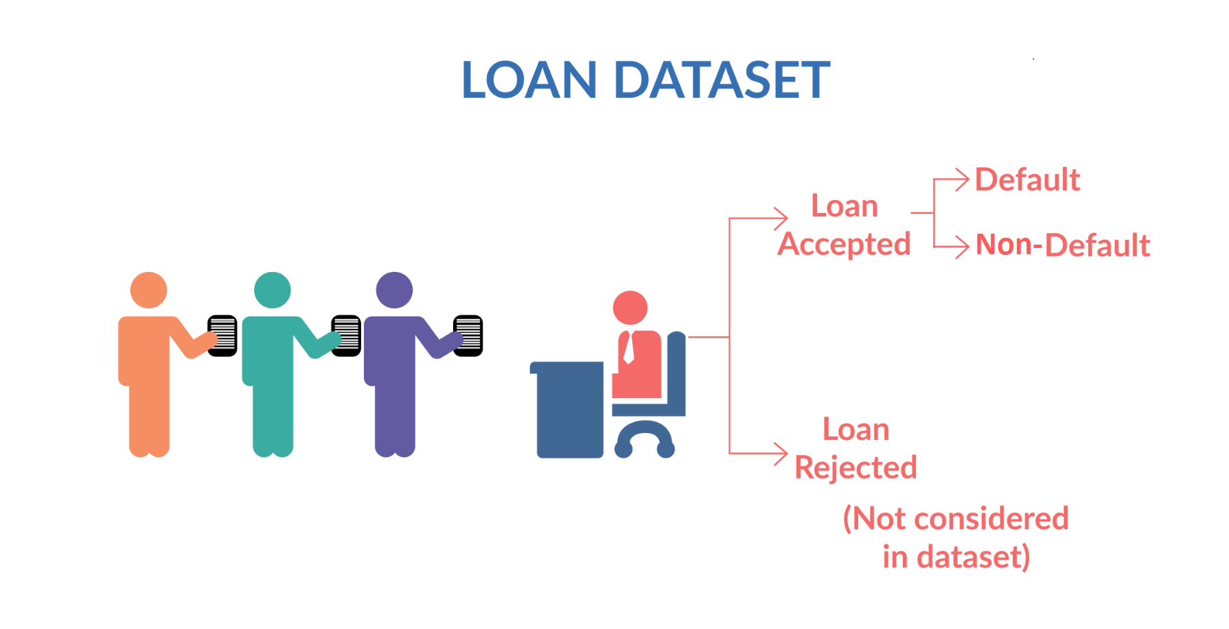
Effective Loan process
Problem statement :
Customer banks decision making whether to accept a loan or to reject it based on applicant eligibility criteria for loan attributes.
For apt decision making there are many Risk factors to be considered based on historical applicant data like credit score ,country code ,type of the loan ,salary and years of experience of the applicant and so on…
We have Two approaches to analyse historical data for above Risks and plotting out defaulters.
Univariant analysis : consider only one factor as variable
Bivariant analysis : consider two factors as variables

Slide 3
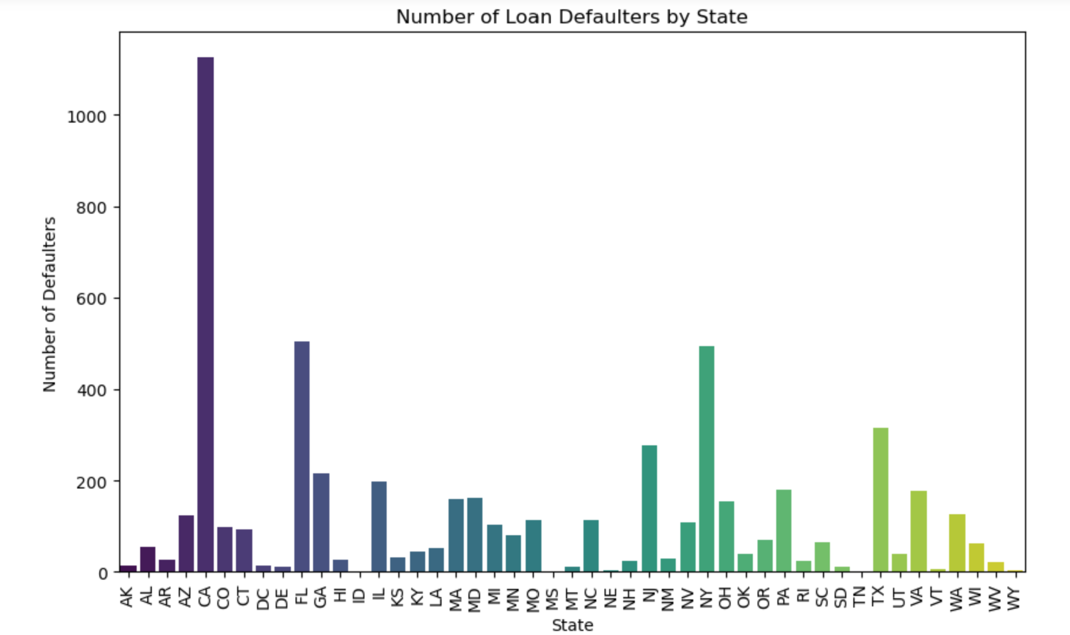
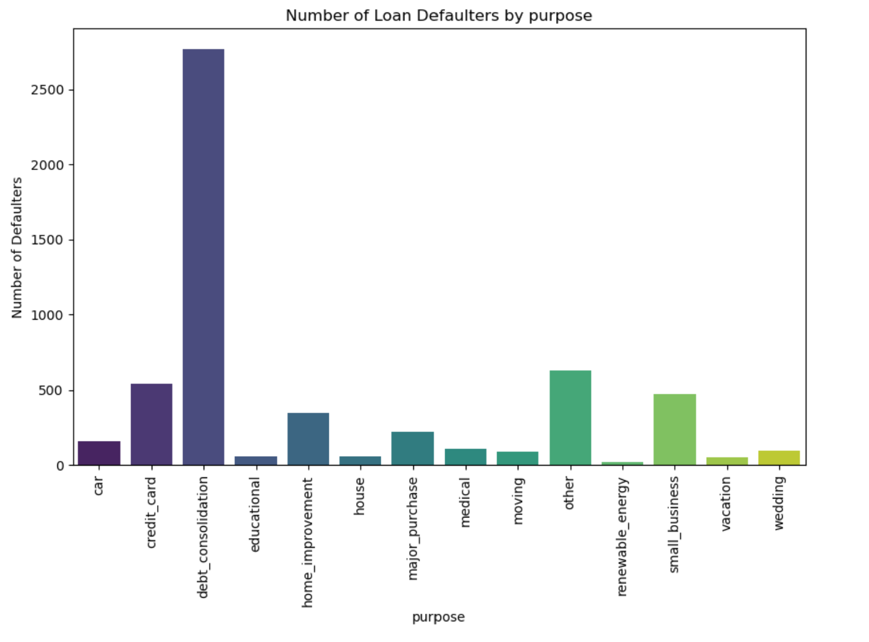
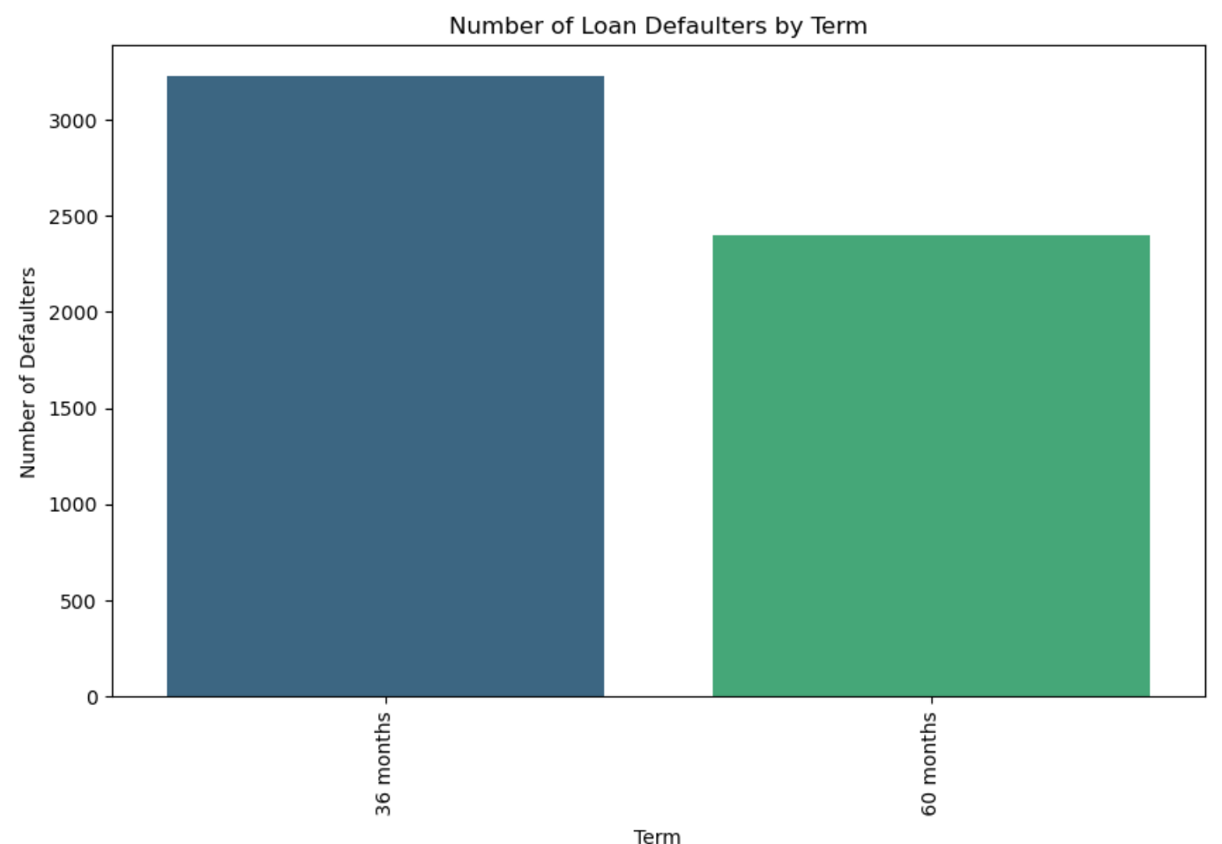
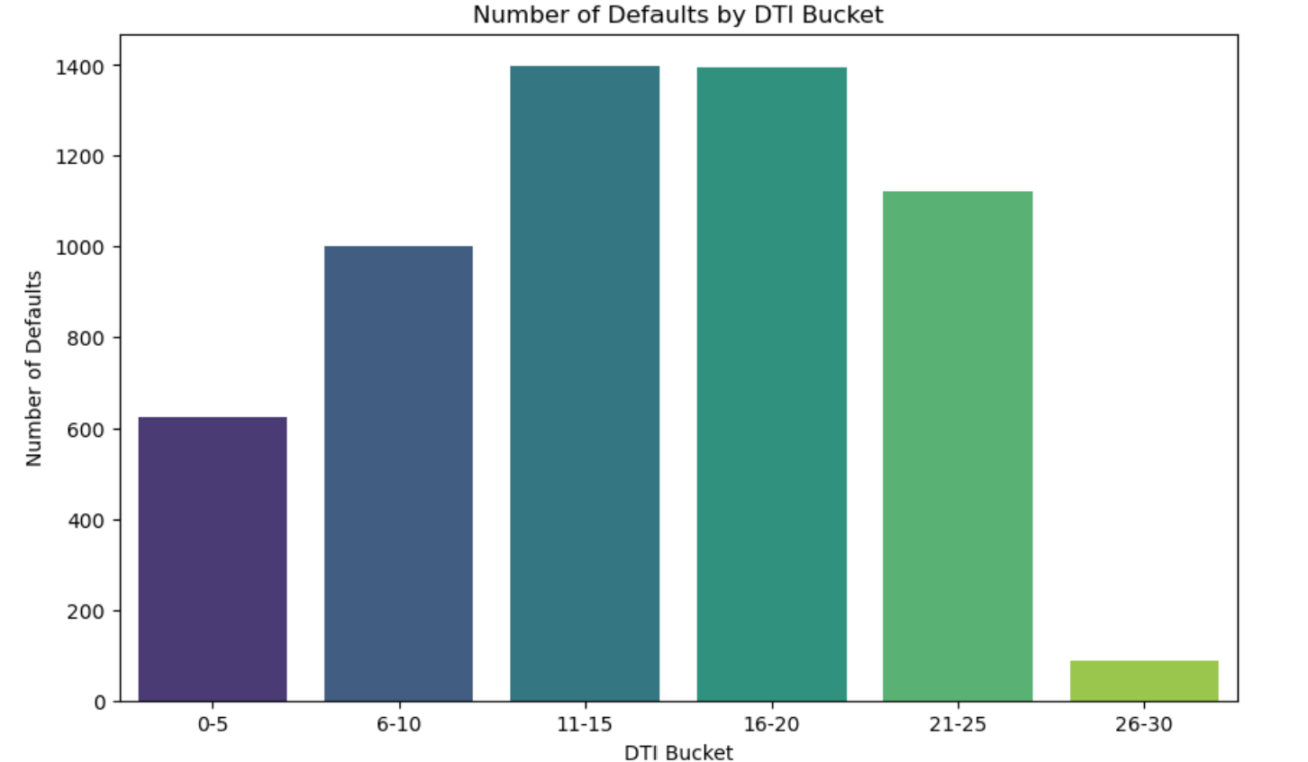
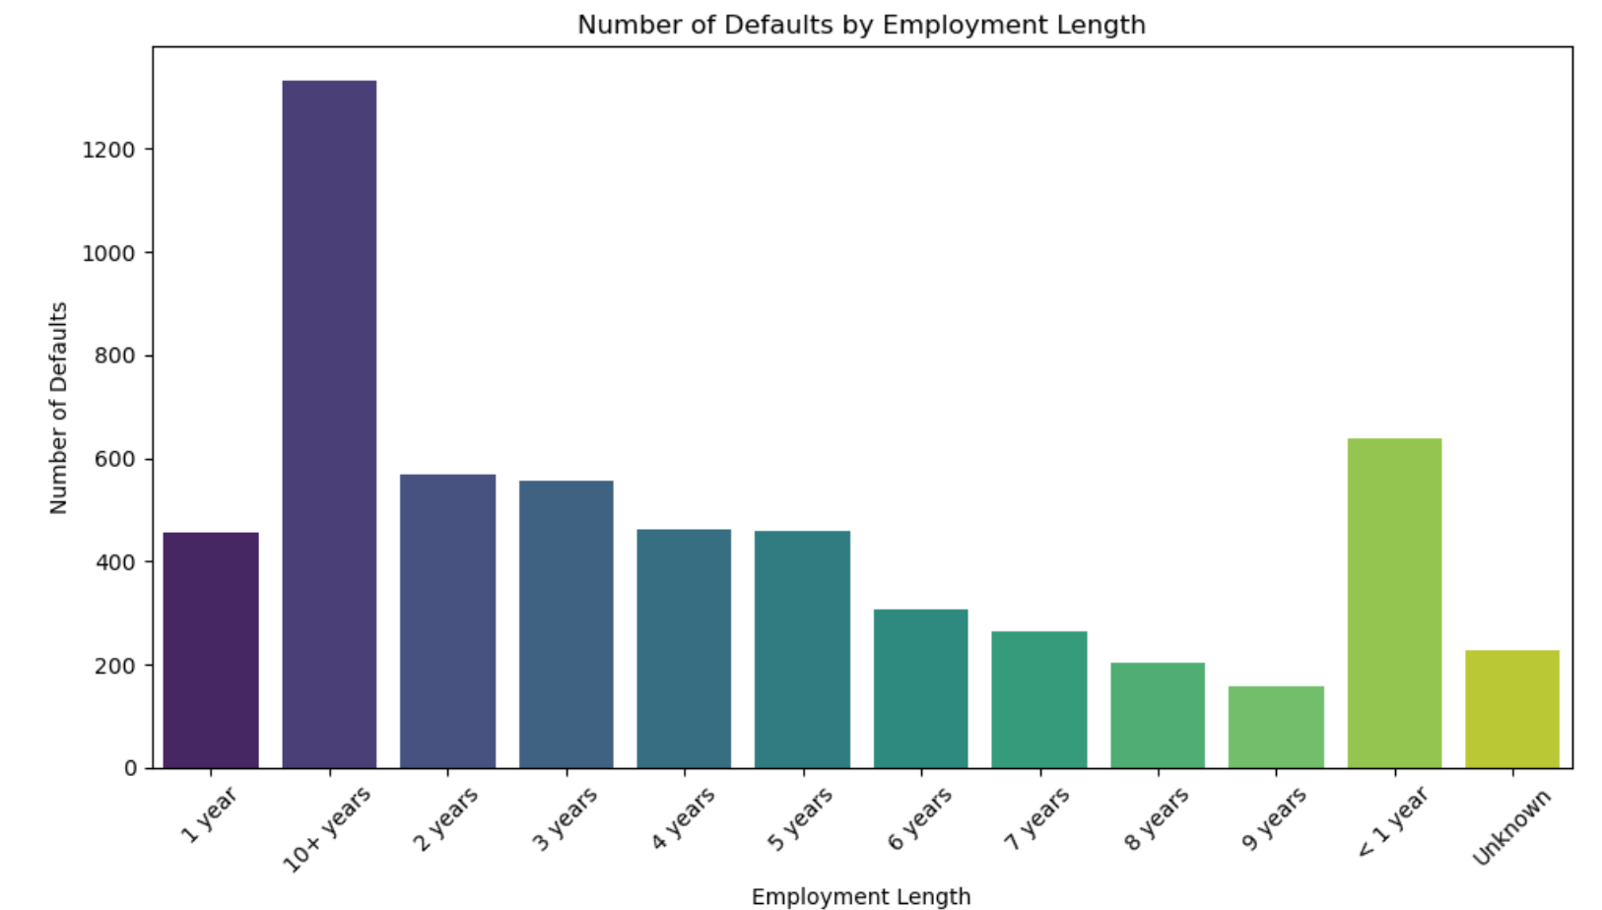
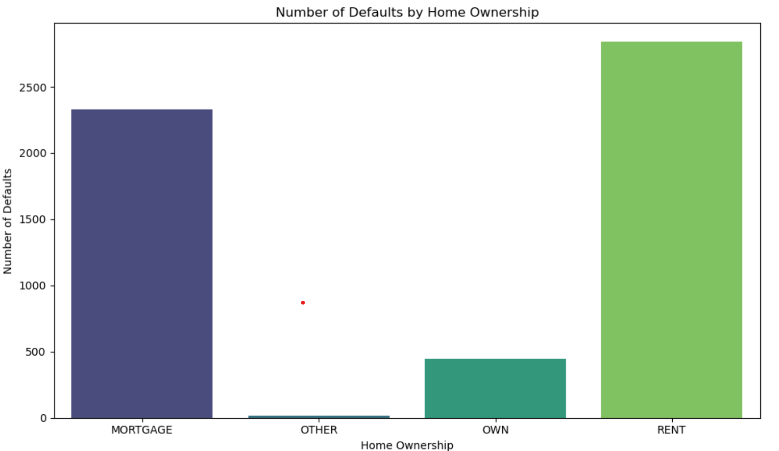
Univariant Analysis Report

Slide 4
Univariant Analysis Summary
parameters | Country/state code | Purpose of Loan | Term /Tenure of loan | DTI Bucket | Employment service | Home ownership
Risky /Defaulters | California( CA) | Debt consolidation | 36 Months | < 25 | >10 years of experience | Rent /Mortgage
Non Risky /Non defaulters | Other states | others | 60 Months | Others | others | others

Slide 5
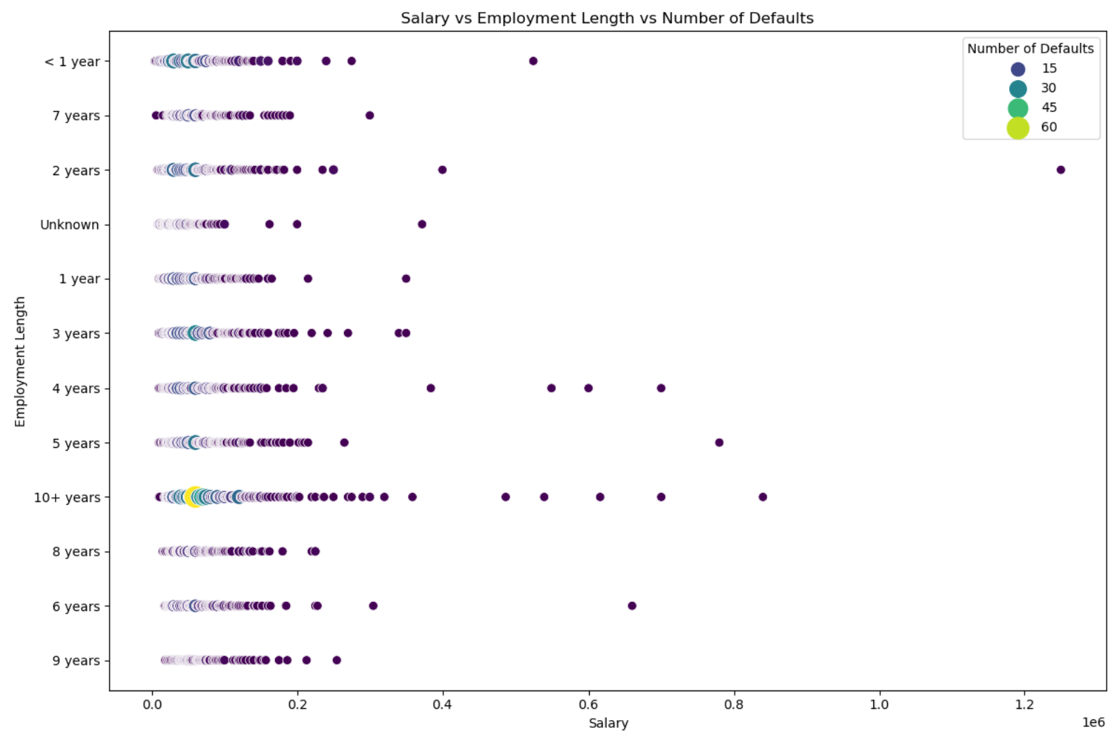
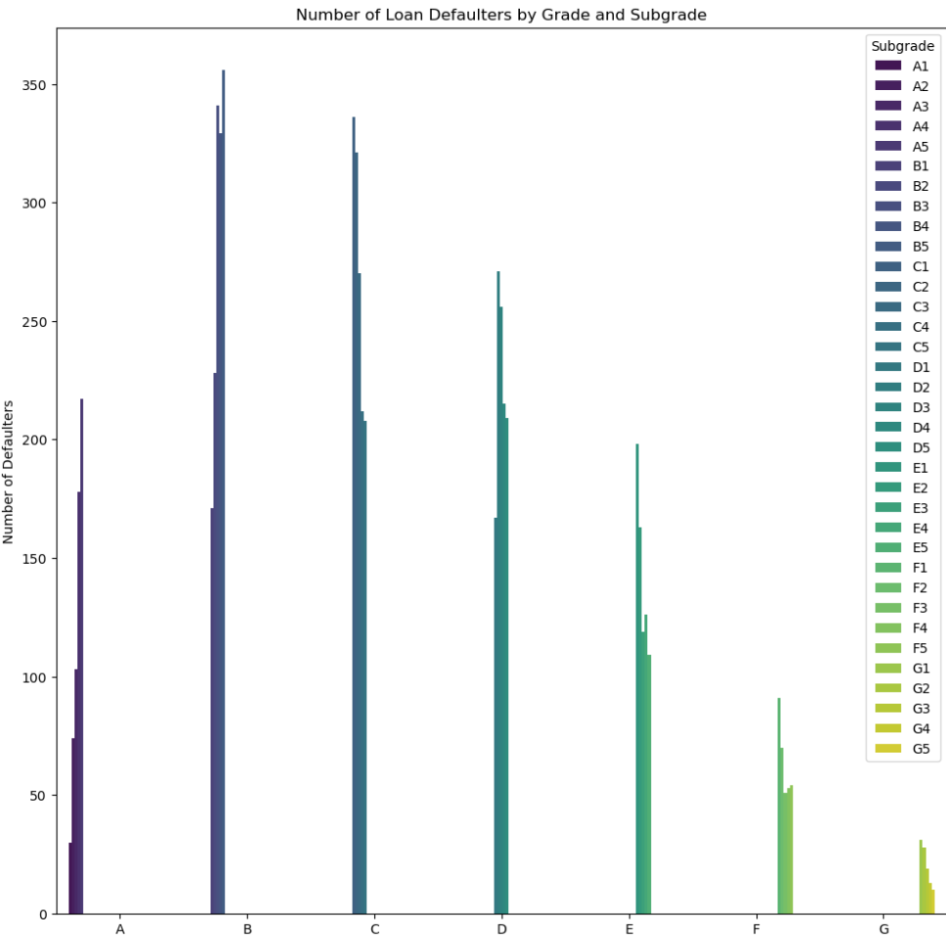
Bivariant Analysis & Summary
 | Salary & years of experience | Grade and subgrade
Risky /Defaulters | Low salary and high years of experience | Except G grade and its sub grade
Non Risky/Non Defaulters | High salary and less years of experience | Only G grade and its sub grades

Slide 6

Any questions ?

Slide 7

Thank You

